Slide 1
Linked List

Slide 2
Array Limitations
What are the limitations of an array, as a data structure?
Fixed size
Physically stored in consecutive memory locations
To insert or delete items, may need to shift data

Slide 3
List Overview
Basic operations of linked lists
Insert, find, delete, print, etc.
Variations of linked lists
Linear Linked list
Circular linked lists
Doubly linked lists

Slide 4
Conceptual Diagram Singly-Linked List
front
head pointer "defines" the linked list
(note that it is not a node)
head
these are nodes
.
data
data
data

Slide 5
Advantages of Linked Lists
The items do not have to be stored in consecutive memory locations: the successor can be anywhere physically
can insert and delete items without shifting data
can increase the size of the data structure easily
Linked lists can grow dynamically (i.e. at run time) – the amount of memory space allocated can grow and shrink as needed

Slide 6
Disadvantages of Linked Lists
A linked list will use more memory storage than arrays. It has more memory for an additional linked field or next pointer field.
Arrays elements can be randomly accessed by giving the appropriate index, while linked list elements cannot randomly accessed.
Binary search cannot be applied in a linked list.
A linked list takes more time in traversing of elements.

Slide 7
Nodes
A linked list is an ordered sequence of items called nodes
A node is the basic unit of representation in a linked list
A node in a singly linked list consists of two fields:
A data portion
A link (pointer) to the next node in the structure
The first item (node) in the linked list is accessed via a front or head pointer
The linked list is defined by its head (this is its starting point)

Slide 8
Linked List Operations
Following are linked list operations:
Add an item to the linked list
Delete an item from the linked list
Add an item to the linked list
We have 3 situations to consider:
insert a node at the front
insert a node in the middle( at particular position)
insert a node at the end
Delete an item from the linked list
We have 3 situations to consider:
delete the node at the front
delete any interior node
delete the last node

Slide 9
A Simple Linked List Class
We use two classes: Node and List
Declare Node class for the nodes
data: int-type data in this example
next: a pointer to the next node in the list
class Node {
public:
int info; // data
Node* next; // pointer to next
};

Slide 10
A Simple Linked List Class
Declare List, which contains
head: a pointer to the first node in the list.
Since the list is empty initially, head is set to NULL
Operations on List
class List {
public:
List(void) {head = NULL;} // constructor
~List(void); // destructor
private:
Node* head;
};

Slide 11
A Simple Linked List Class
Operations of List
IsEmpty: determine whether or not the list is empty
InsertNode: insert a new node at a particular position
FindNode: find a node with a given value
DeleteNode: delete a node with a given value
DisplayList: print all the nodes in the list

Slide 12
Inserting a new node
Possible cases of InsertNode
Insert into an empty list
Insert in front
Insert at back
Insert in middle
But, in fact, only need to handle two cases
Insert as the first node (Case 1 and Case 2)
Insert in the middle or at the end of the list (Case 3 and Case 4)

Slide 13
Insertion at the Start
It is just a 2-step algorithm which is performed as follows
Assume
node points to the new node to be inserted
front points to the first node of the linked list
Make the new node point to the first node
(i.e. the node that front points to)
2. Make front point to the new node
(i.e the node that node points to)

Slide 14
Inserting a Node at the Front
node points to the new node to be inserted,
front points to the first node of the linked list
node
front
node
Make the new node point to the first node
(i.e. the node that front points to)
front
node
2. Make front point to the new node
(i.e the node that node points to)
front

Slide 15
Algorithm
void insert_beg(int val)
{ node *temp=new node;
temp->info=val;
If(head==NULL)
{ head=temp;
temp->next=NULL}
else{
temp->next=head;
head=temp; }
}

Slide 16
Insertion at the End
void Insert_End(int val)
{ node *temp=new node;
temp->info=val;
temp->next=NULL;
if(head==NULL)
{
temp->next= NULL
head=temp;
}
else { Node *cur ;
cur=head;
while(cur ->next!=NULL)
{
cur=cur->next;
}
cur->next=temp;
}
}

Slide 17
Insertion at Particular Position
In this case, a new node is inserted between two consecutive nodes.
Here, We call one node as current and the other as previous
Now the new node can be inserted between the previous and current node by just performing two steps:
Pass the address of the new node in the next field of the previous node.
2. Pass the address of the current node in the next field of the new node.
OVERFLOW
Overflow is a condition that occurs when we try to create a node but there is not a sufficient memory available.

Slide 18
Inserting a Node in the Middle
node
Let's insert the new node after the third node in the linked list
front
insertion point
1. Locate the node preceding the insertion point , since it will have to be modified (make current point to it)
node
front
current

Slide 19
2. Make the new node point to the node after the insertion point (i.e. the node pointed to by the node that current points to)
node
front
current
node
3. Make the node pointed to by current (i.e. current point to the new node
front
X
current

Slide 20
Algorithm
Algorithm--Insertion after a specific position
void insert_position(int pos, int val)
{ node *pre;
node *cur;
node *temp=new node;
temp->data=val;
cur=head;
for(int i=1;i<pos;i++)
{ pre=cur; cur=cur->next; }
pre->next=temp;
temp->next=cur; }

Slide 21
Algorithm--Insertion after a specific value
void insert_specificValue(int sp_val, int data)
{ node *pre;
node *cur;
node *temp=new node;
temp->data=data;
cur=head;
while (cur->data!= sp_val)
{ pre=cur; cur=cur->next; }
temp->next=cur;
pre->next=temp;
}

Slide 22
Comparison --- Insertion in between two nodes
void insert_position(int pos, int val)
{ node *pre;
node *cur;
node *temp=new node;
temp->data=val;
cur=head;
for(int i=1;i<pos;i++)
{ pre=cur; cur=cur->next; }
pre->next=temp;
temp->next=cur; }
void insert_specificValue(int sp_val, int data)
{ node *pre;
node *cur;
node *temp=new node;
temp->data=data;
cur=head;
while (cur->data!= sp_val)
{ pre=cur; cur=cur->next; }
temp->next=cur;
pre->next=temp;
}

Slide 23
Deleting a Node from a Linked List
We will consider three cases and then see how deletion is done in each case.
Case 1: The first node is deleted.
Case 2: The last node is deleted.
Case 3: The node after a given node is deleted.
UNDERFLOW.
A condition that occurs when we try to delete a node from an empty linked list
This happens when Head = NULL or when there are no more nodes to delete.
Note that when we delete a node from a linked list, we actually have to free the memory occupied by that node. The memory is returned to the free pool so that it can be used to store other programs and data.

Slide 24
Deleting the First Node from a Linked List
To delete a node from the beginning of the list, then the following changes will be done in the linked list
Step 1: check if the linked list exists or not.
If Head = NULL, then there are no nodes in the list and the control is transferred to the last statement of the algorithm. (UNDERFLOW)
Step 2: However, if there are nodes in the linked list,
A pointer variable PTR is set to point to the first node of the list.
(i.e. initialize PTR with Head that stores the address of the first node )
Step 3: Head is made to point to the next node in sequence
Step 4: Finally, the memory occupied by the node pointed by PTR (initially the first node of the list) is freed and returned to the free pool.

Slide 25
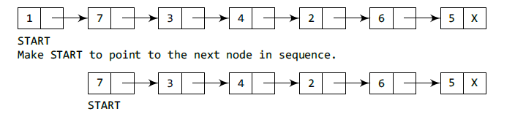
Head
Head
Head
Deleting the First Node
if (head==NULL)
cout<<“Underflow<<endl;
else
node *ptr;
ptr = head;
head=head→next;
delete ptr;

Slide 26
Deleting the Last Node from a Linked List
Following steps will be required
Step 1: check if the linked list exists or not.
If Head = NULL, then there are no nodes in the list and the control is transferred to the last statement of the algorithm. (UNDERFLOW)
Step 2: take a pointer variable PTR and initialize it with head.
That is, PTR now points to the first node of the linked list.
Step 3: take another pointer variable PREPTR
In the while loop, we take another pointer variable PREPTR such that it always points to one node before the PTR.
Once we reach the last node and the second last node, we set the NEXT pointer of the second last node to NULL, so that it now becomes the (new) last node of the linked list. The memory of the previous last node is freed and returned back to the free pool.

Slide 27
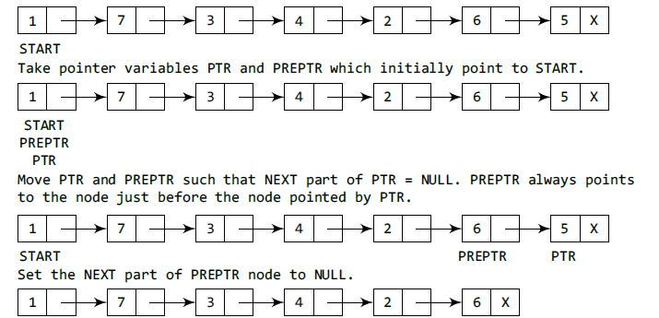
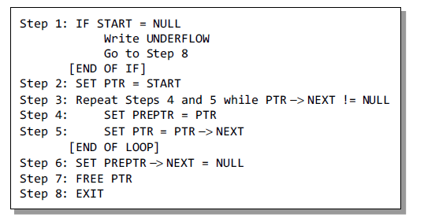
NOTE: Here START means Head.

Slide 28
Deleting the Specific Node in a Linked List
following changes will be done in the linked list:
Step 1: check if the linked list exists or not.
If START = NULL, it signifies that there are no nodes in the list and the control is transferred to the last statement of the algorithm.
Step 2: we take a pointer variable PTR and initialize it with START.
That is, PTR now points to the first node of the linked list. In the while loop, we take another pointer variable PREPTR such that it always points to one node before the PTR.
Once we reach the node containing VAL and the node succeeding it, we set the next pointer of the node containing VAL to the address contained in next field of the node preceeding it. The memory of the node succeeding the given node is freed and returned back to the free pool.

Slide 29
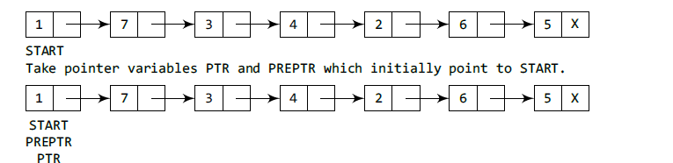
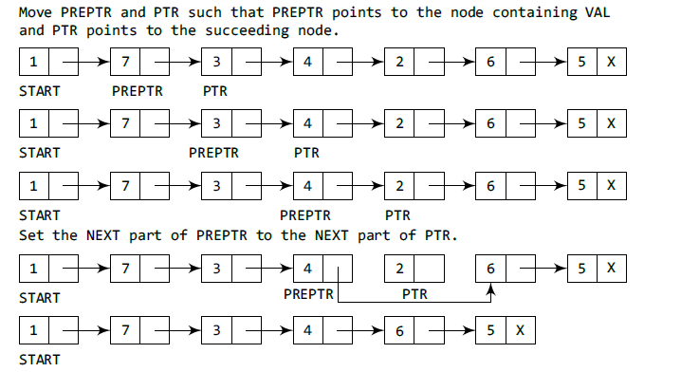

Slide 30
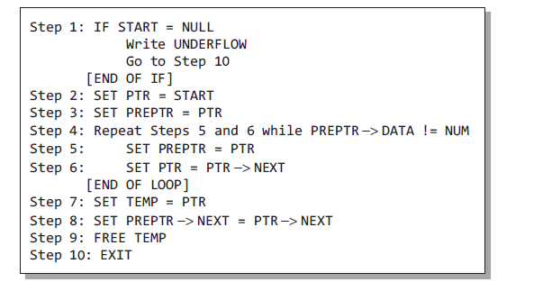
Algorithm: Deleting the Specific Node

Slide 31
Video Lecture of the topic can be found at
Basics of Linked List
https://youtu.be/5c6dNBc5qcM
How to Add Nodes to Linked List
https://youtu.be/7R49RIDJPNM
How to delete node from Linked List
https://youtu.be/3vcY0A0OfX4
How to Insert Node in Circular Linked List
https://youtu.be/4Xx6_NkimR4
How to Delete Node from a Circular Linked list
https://youtu.be/kvlPdTZxvD0
How to Add Node to Doubly Linked List
https://youtu.be/U83OzP6wgQ0
How to Delete Node From a Double Linked List
https://youtu.be/c4cDosriVMs
Analysis of Linked List Operations
https://youtu.be/NPsutdKrKNw

